Slide 1
Innovative Leadership & Collaboration for Sustainable Development Growth in Zanzibar
ZANZIBAR CEO’S FORUM 2025 “Innovative Leadership and Collaboration for Sustainable Development Growth in Zanzibar”
11th- 13th May, 2025 Golden Tulip Airport Hotel Zanzibar
Prof. Moh’d Makame Haji

Slide 2
Introduction – Who is CEO
Legal perspective on the status and responsibilities of CEOs in Zanzibar
CEO as a Leader
Innovative Leadership
Integrating Strategic Leadership for Results
The of Collaboration in Sustainable growth in Zanzibar
CEOs in Implementing Zanzibar Development Plans, Policies and SDGs
Innovative Principles for Achieving Targets in Zanzibar’s Development Plans, Policies, and SDGs
Essential Leadership Qualities for CEOs in Zanzibar
Leading Challenges

Slide 3
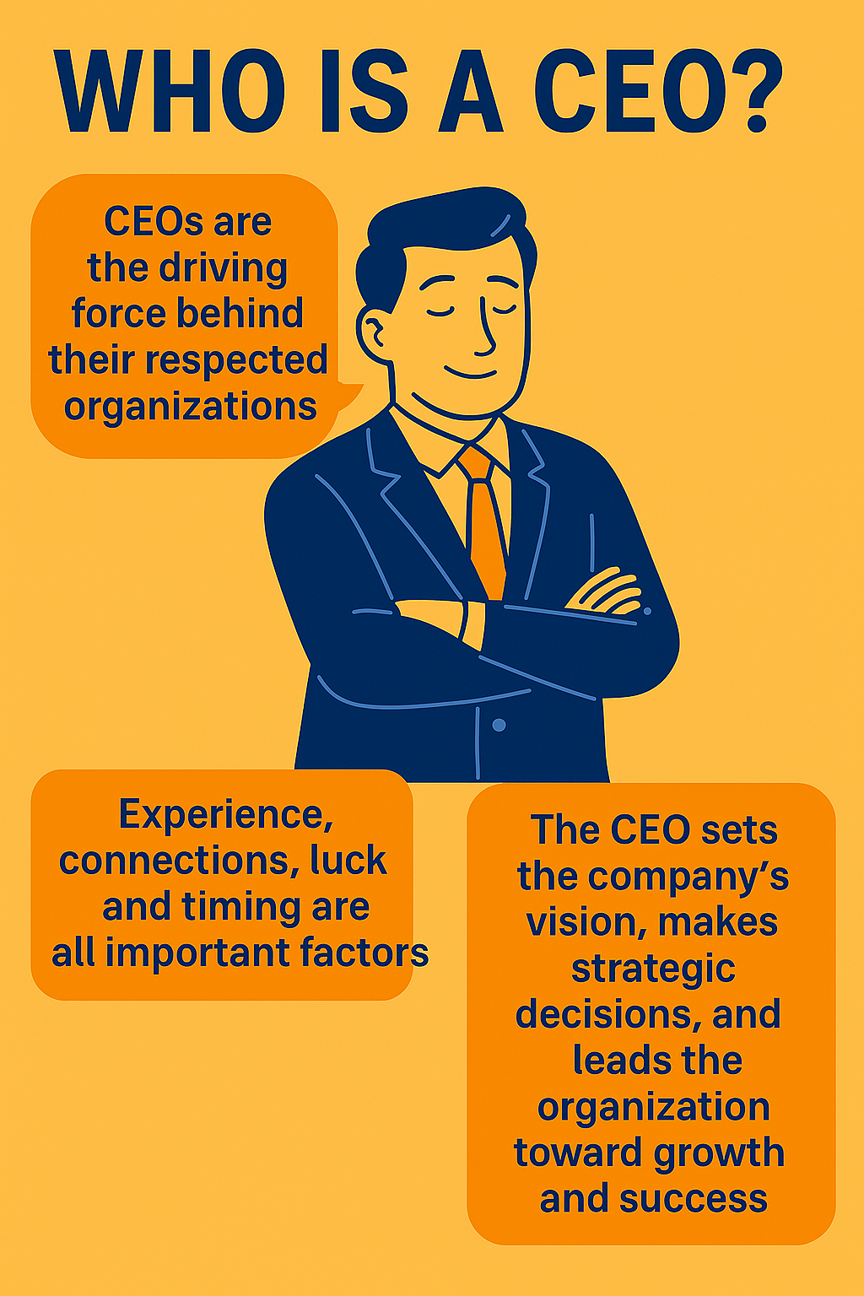

Slide 4
Legal perspective on the status and responsibilities of CEOs in Zanzibar
Law/Act | Legal Status of CEOs & Local Government Leaders
Constitution of Zanzibar 1984 | Defines governance structures; CEOs operate within corporate frameworks, while local government leaders manage administrative and political functions.
Companies Act No. 12 of 2002 | Establish corporate responsibilities in private sector
Act Establishing the Public Institutions | Grants authority to CEOs within specific institutions and defines the roles of local government leaders in governance.
Zanzibar Public Service Act, 2011 | Governs CEOs in public institutions and local government leaders, detailing responsibilities, ethical obligations, and service delivery.
Companies Act No. 12 of 2002 | Regulates corporate CEOs, setting governance, fiduciary duties, and accountability measures.
Public Procurement and Disposal Act No. 11 of 2016 | Defines CEOs’ responsibilities in procurement processes and ensures transparency in local government procurement.
Public Finance Management Act No.12 of 2016 | Establishes CEOs’ financial governance roles and regulates financial management within local government authorities.
Finance (Public Revenue Management) Act | Regulates CEOs’ obligations regarding taxation, revenue collection, and financial oversight, while also guiding local government financial administration.
Office of Treasury Registrar and Public Asset Management Act No.6, 2021 | Regulates Public Investment Entities and manage assets of public institutions

Slide 5
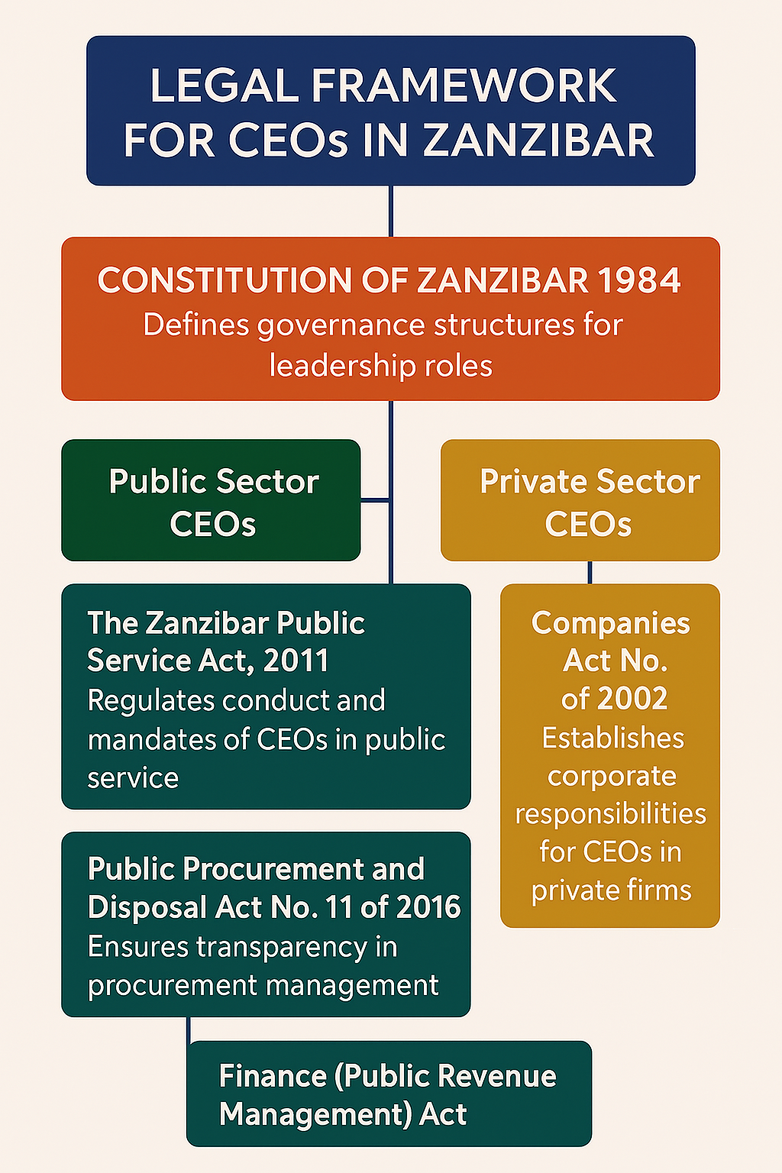

Slide 6
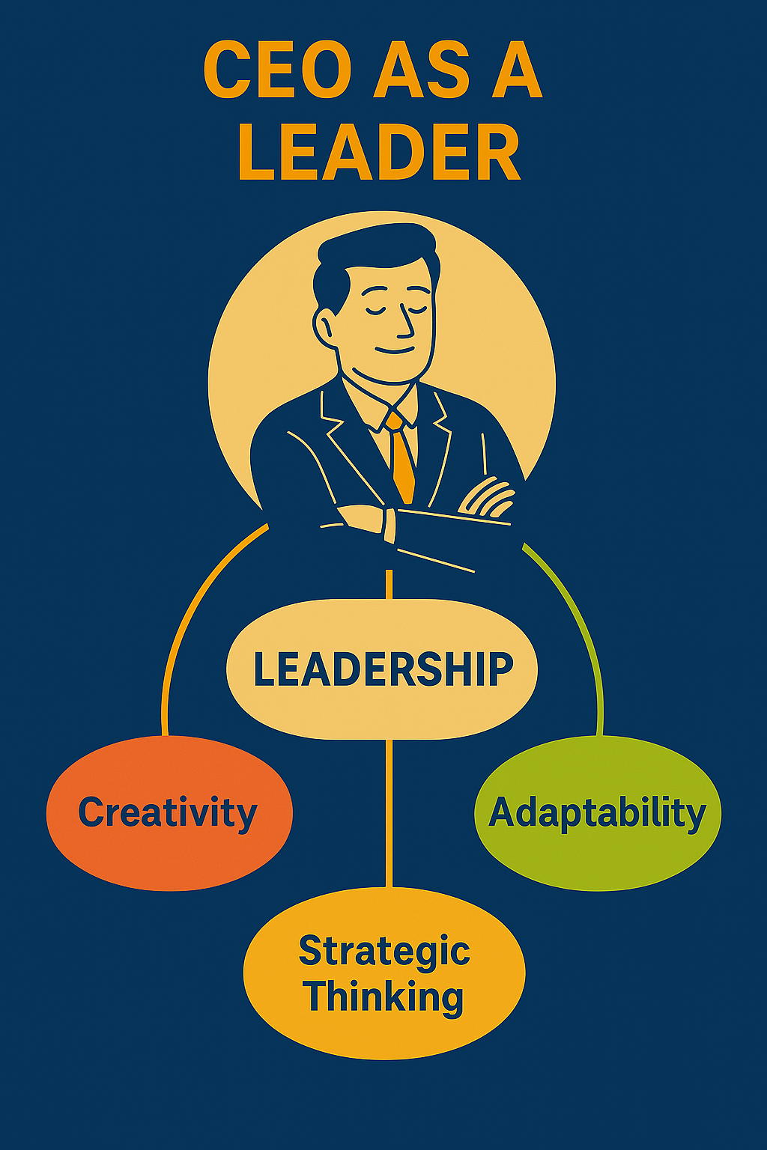

Slide 7
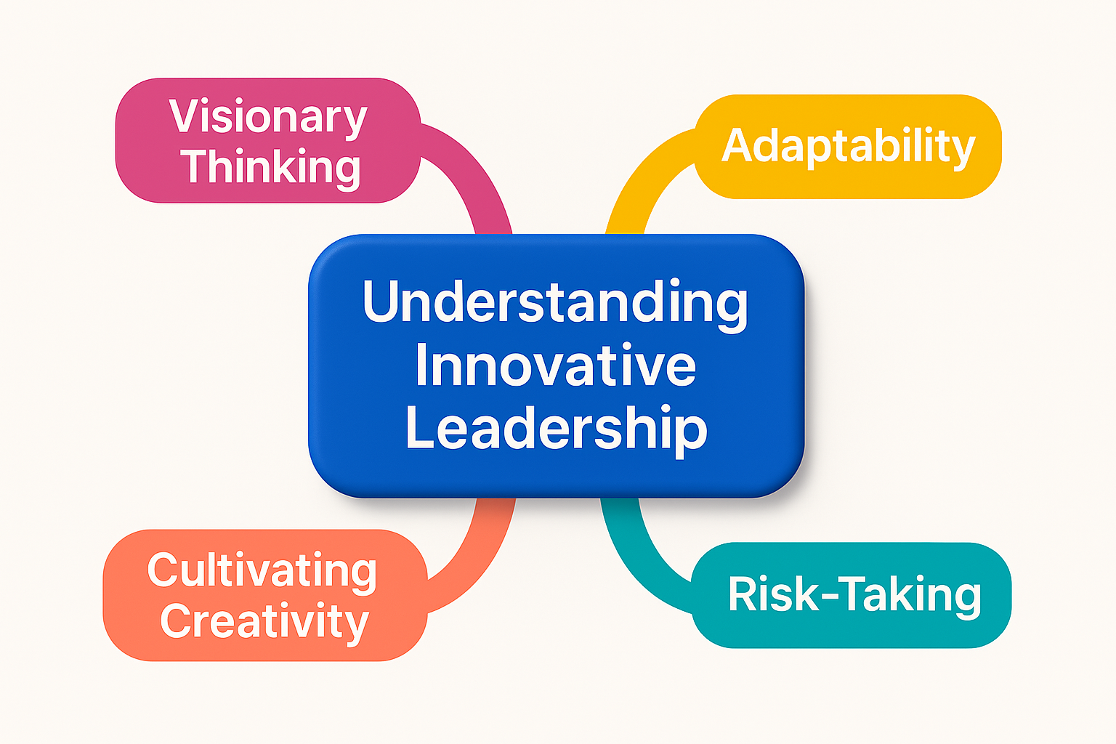
Innovative Leadership

Slide 8


Slide 9
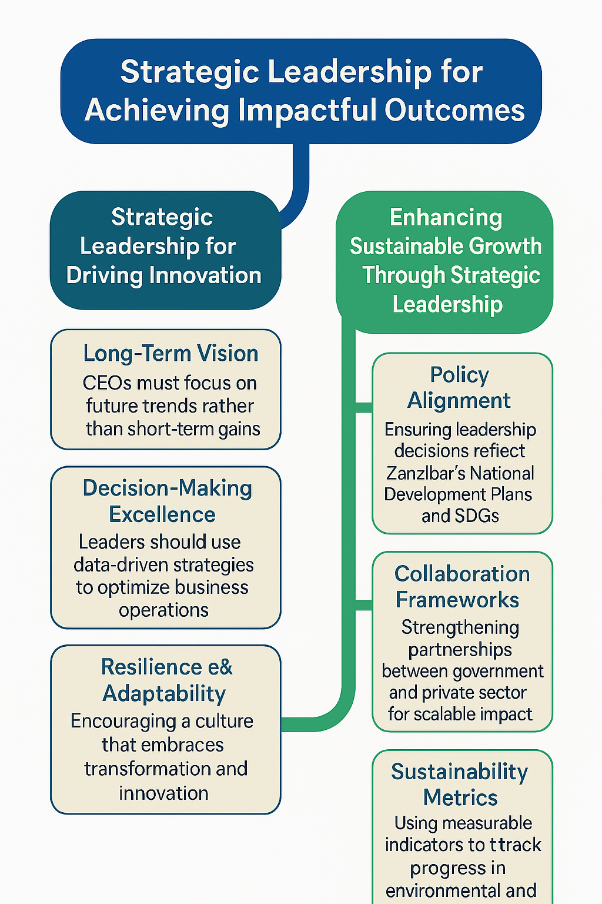
Integrating Strategic Leadership for Results

Slide 10
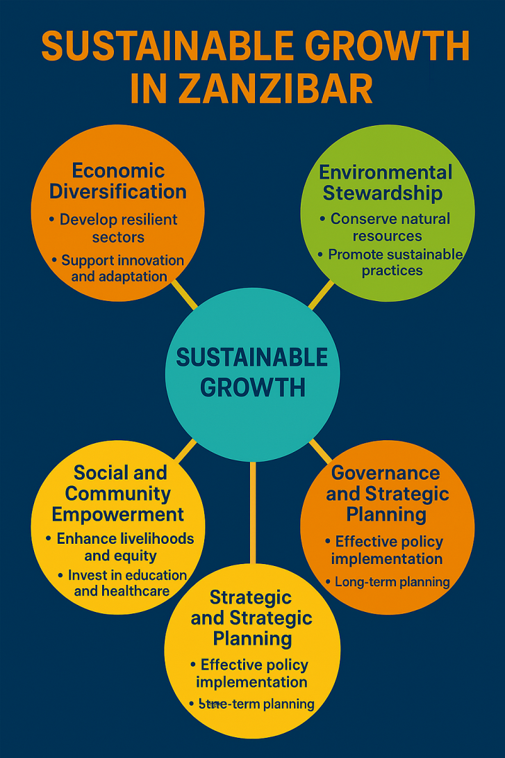

Slide 11
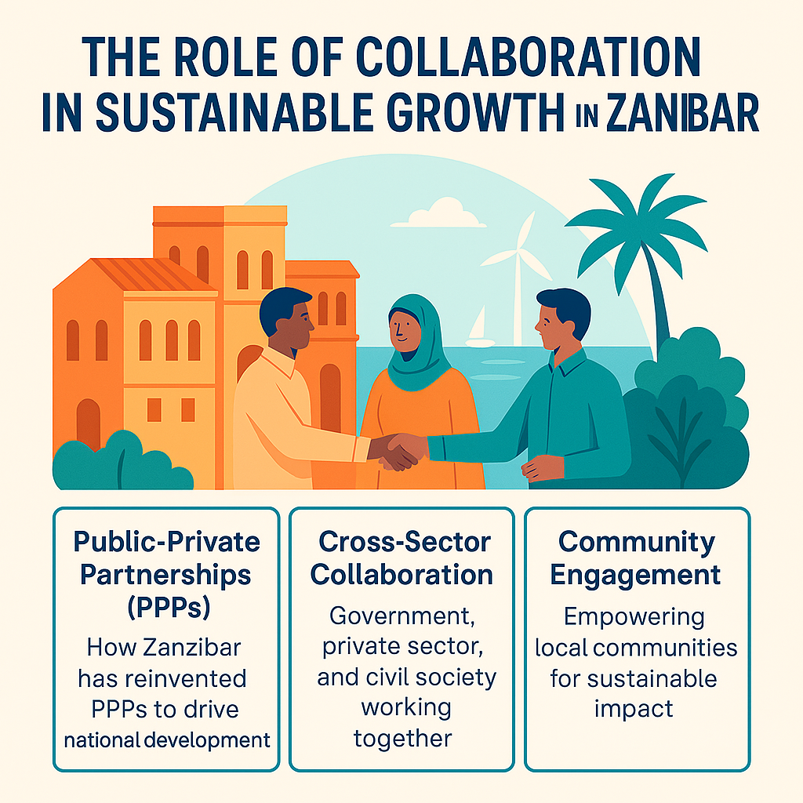

Slide 12
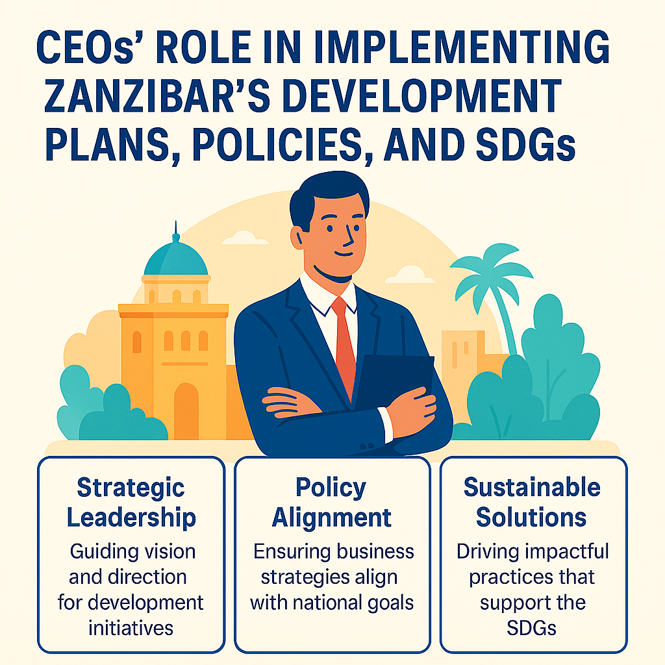

Slide 13
Innovative Principles for Achieving Targets in Zanzibar’s Development Plans, Policies, and SDGs
The Zanzibar Sustainable Development Plan offers a strategic framework that aimed at fostering inclusive economic growth, environmental sustainability, and social equity to achieve global and regional development agendas, including the Sustainable Development Goals (SDGs) and Agenda 2063.
CEOs must embrace innovative principles that drive sustainable growth.

Slide 14
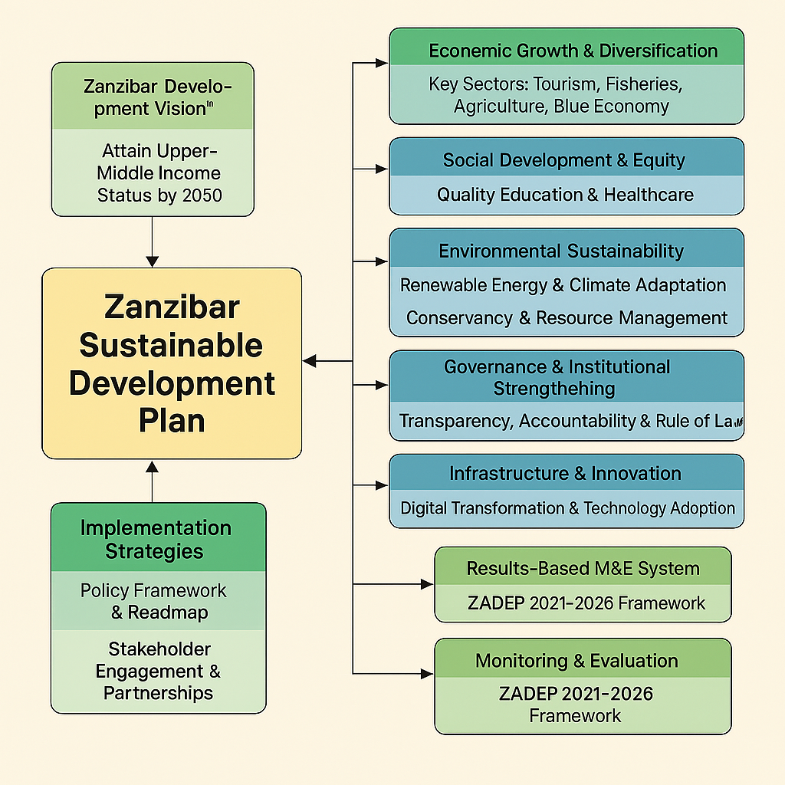

Slide 15
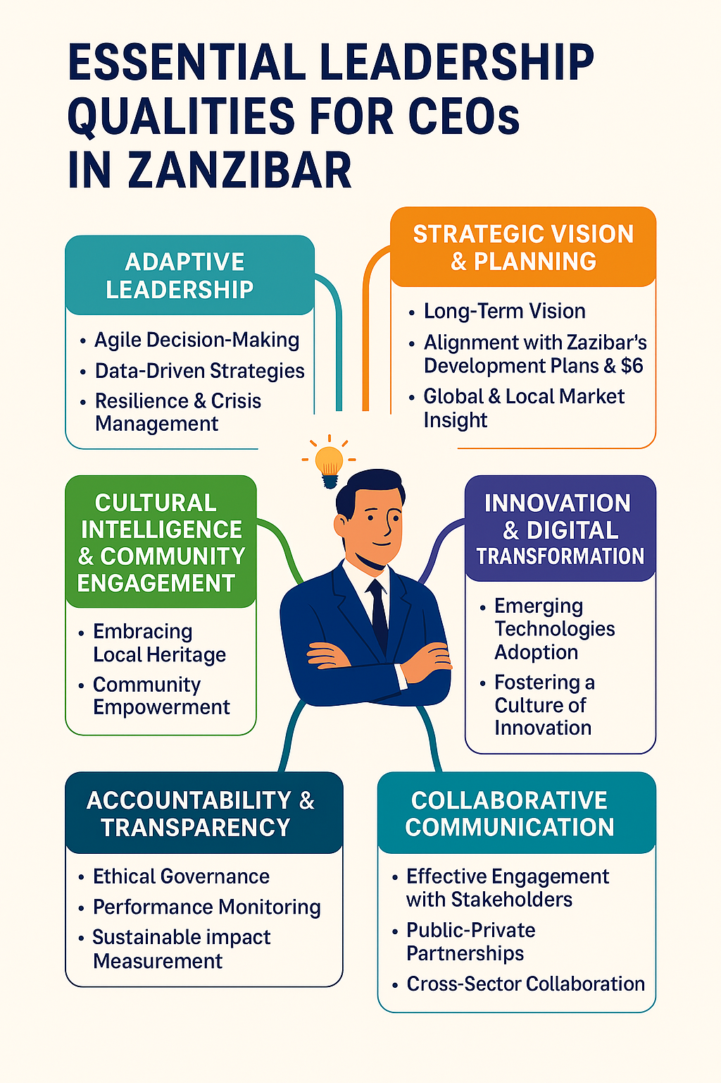

Slide 16
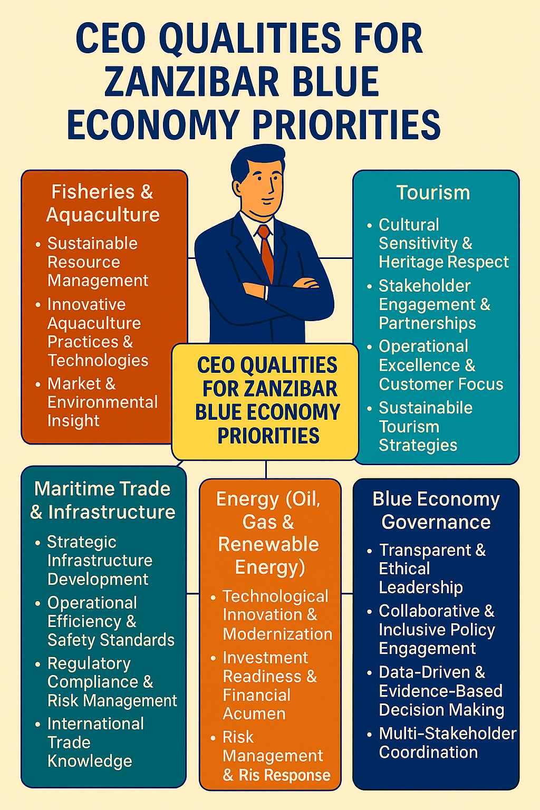

Slide 17
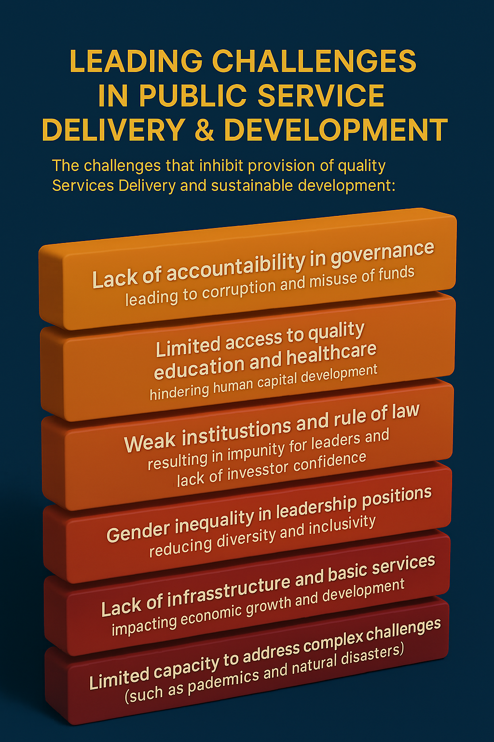

Slide 18
